Slide 1
Learning HTML CSS JavaScript Bootstrap with Python to Make Websites
Soumil Nitin Shah
Bachelor in Electronic Engineering
Master in Electrical Engineering
Master in Computer Engineeirng

Slide 2


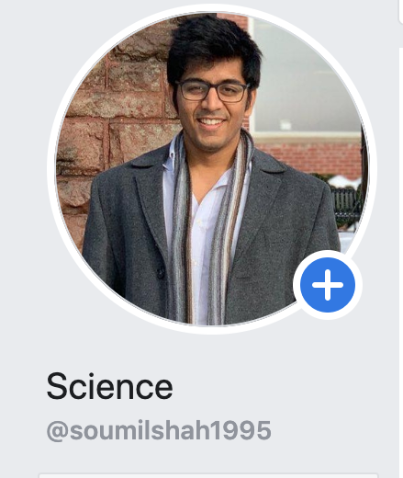
About Soumil Shah
Hello! I’m Soumil Nitin Shah, a Software and Hardware Developer based in New York City. I have completed by Bachelor in Electronic Engineering and my Double master’s in Computer and Electrical Engineering. I Develop Python Based Cross Platform Desktop Application , Webpages , Software, REST API, Database and much more I have more than 2 Years of Experience in Python
Youtuber with 2.5K Subscribers [Teach Python]
Blog Link
Website : Link
FaceBook Link
LinkedIn Link

Slide 3
What Is Html?
HTML is short for HyperText Markup Language. It’s code that we use to:
create documents that are stored on the World Wide Web and displayed in a browser.
provide a basic structure for our web page - the bones of the web page.
ensure proper loading of text and images for our browser to display.

Slide 4
When Do We Use Html?
Every web page you see on the World Wide Web is written using HTML code. Buttons, images, forms, sections of text - these are all elements that are created with HTML.
If we think of our web page as a human body, HTML is the bone structure. We can add skin and clothing to the body by using CSS, but only once we have that skeletal structure in place.

Slide 5

Software Requirement
Atom Software Link

Slide 6
HTML In Action

Slide 7
Tags
The essence of HTML programming is tags
A tag is a keyword enclosed by angle brackets ( Example: <I> )
There are opening and closing tags for many but not all tags; The affected text is between the two tags
The opening and closing tags use the same command except the closing tag contains and additional forward slash /
For example, the expression <B> Warning </B> would cause the word ‘Warning’ to appear in bold face on a Web page

Slide 8
Tags
<!-- opening tag --> <p> <!-- closing tag --> </p>

Slide 9
Parts of an HTML Element

Slide 10
Other Tag
<h1>My Day In The Garden</h1>. [Heading Tag] we have h1 to h6
<b>BOLD TAG </b>. [Bold Tag]
<i>TEXT</i> [italic TEXT tag]
<img src="" alt="">. [Image Tag]
<BR> Next Line
And so on ………
No Need to Remember all of this IDE Takes care of that lets us see how

Slide 11
Lets us see examples on H Tag with Bootstrap and CSS
Lets go to Atom

Slide 12
Lets us see Example on IMG Tag with Bootstrap and CSS
Lets go to Atom Editor

Slide 13
Lets us See examples on HREF using Bootstrap and CSS
Lest go to Atom Editor and see examples

Slide 14

Exercise 1 code the Following HTML Page
Remember we need IMG Tag and H Tag and P Tag

Slide 15
What are New Tag you Observed ?
<section> <h2>Information about me</h2> <p>I am coding out my first website. This is a paragraph that I would write with information about my interests.</p> <h3>My favorite websites</h3> <ul> <li><a href="www.google.com">Google</a></li> </ul> <h3>My favorite books</h3> <section> <h4>Non-Fiction</h4> <ol> <li>Eloquent Javascript</li> </ol> </section>

Slide 16
Example on Order and Unorder List
Back to Atom

Slide 17
Exercise
Try to add Hyper Link to order and unorder list

Slide 18
Some More Tag
<hr>. Horizontal Rule
<br>. Break

Slide 19
Part II. HTML
Forms

Slide 20
What is Form ?
A <form> is used to collect information from a user. For a <form> to work, it needs to send the data it collects somewhere to be processed or handled. Therefore, <form>often requires additional attributes:

Slide 21
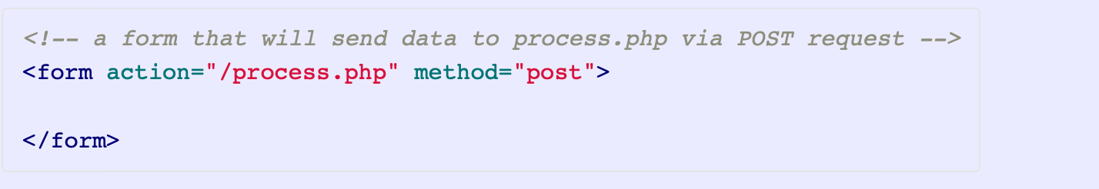
Form
action - the destination of the form data when the form is submitted
method - indicates whether the data should be processed using a GET or a POST type of request.

Slide 22
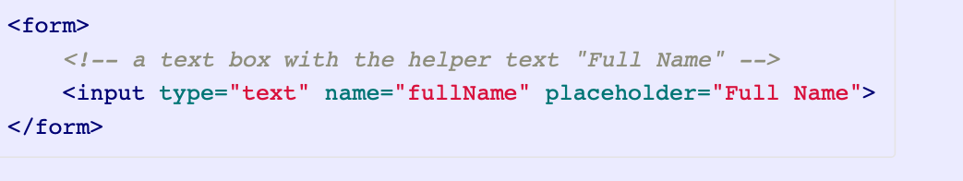
Input
<input> is the element used by a <form> to collect information.
An <input> element also usually has a name attribute that is used by databases to identify the field to which submitted data belongs.
The <input> element is very versatile: by specifying the type attribute, it can be rendered as a text field, calendar-style date picker, radio button, dropdown, and more. You can consult some external documentation to see a more complete list.

Slide 23
Lets us see Few Example
Back to Atom

Slide 24
Form Validation
Lets us go back to Atom and Learn about Form Validation

Slide 25
Drop Down and Radio Button
Lets us go back to Atom Editor and see some Example

Slide 26
CSS

Slide 27
What Is CSS?
CSS is short for Cascading Style Sheets. It’s code that we use to:
describe how HTML elements are to be laid out on a web page.
style HTML elements including colors, sizes, and fonts.

Slide 28
When Do We Use CSS?
very web page that you see on the Internet that has any kind of color or style has that code written using CSS. Font type, size, background color, shadows - these are all created with CSS.
If we think of our web page as a human body, CSS is the skin and clothing that we add to our HTML content (which is the skeleton).

Slide 29
CSS In Action

Slide 30
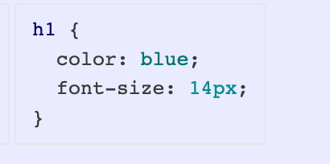
CSS Rule Set
To set a style on an HTML element, we need to write a CSS rule set.

Slide 31
CSS
The selector can be an HTML element name, a class, or an id. Classes are denoted with a . as a prefix to the name (e.g. .blog-pics). Ids are denoted with a # as a prefix to the name (e.g. #fauna-title).
Curly braces {} declare the start and end of the styling of a specific element.
A property and value pair is called a declaration.
The property and value are separated by a colon :.
Each declaration is ended with a semi-colon ; to separate it from any subsequent declarations.
The styles specified by each declaration are applied to all of the HTML elements specified by the selector.

Slide 32
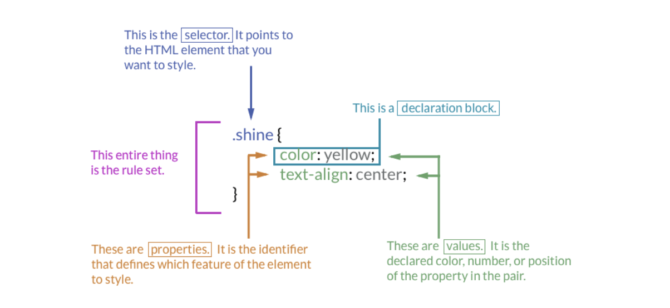
Parts of a CSS Rule Set

Slide 33
Selectors

Slide 34
Types of Selector
Selectors
Element Name
IDs
Classes

Slide 35
SELECTORS
Selectors are patterns used to select the element(s) that you want to style.
Vocabulary
selector - the part of a CSS rule set that comes before the opening curly brace and says what elements this ruleset will apply to
element - an item in HTML defined by its opening and closing tags
id - a property listed as an attribute in the opening tag of one HTML element
class - a property listed as an attribute in the opening tag of several HTML elements

Slide 36
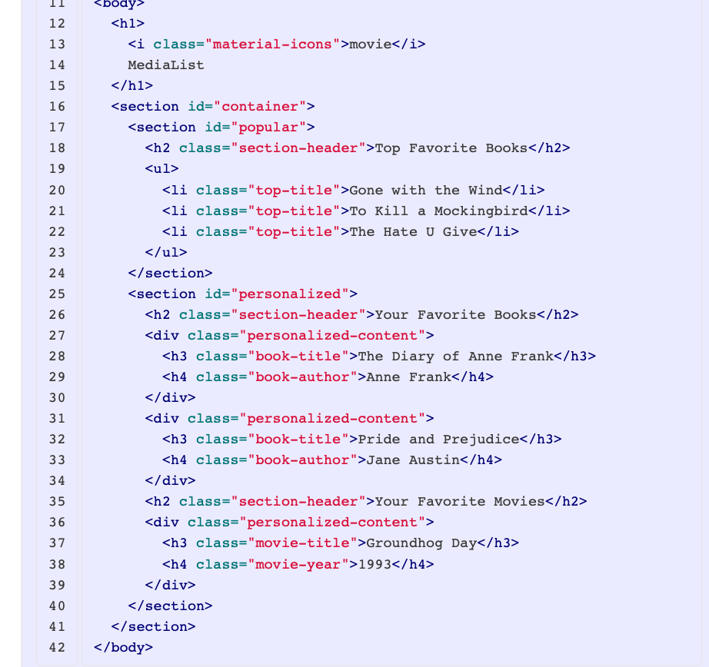
CSS SELECTOR

Slide 37

Selecting by Tag Name

Slide 38
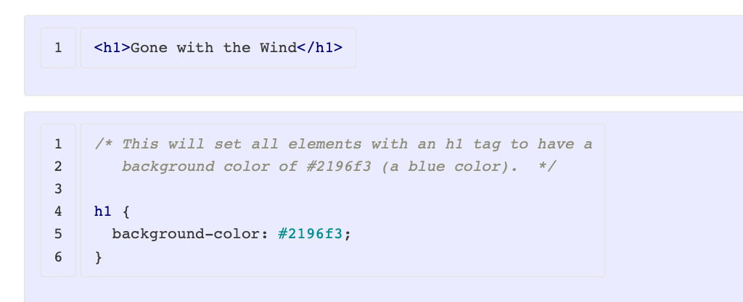
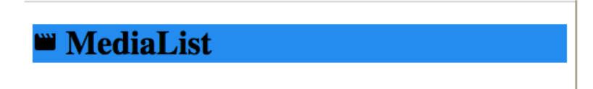
SELECTING BY TAG NAME

Slide 39
Styling by Class Name

Slide 40
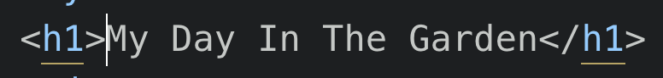
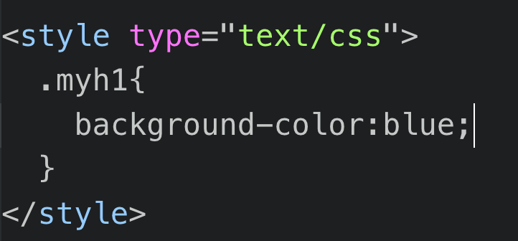
Selecting by Class

Slide 41
Styling by ID

Slide 42
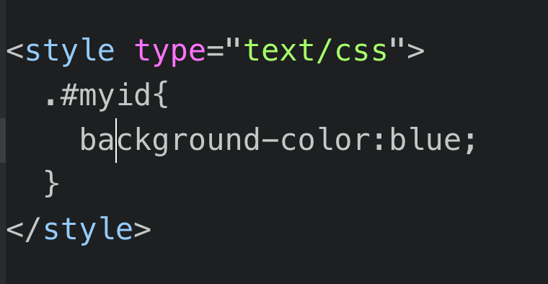
Styling by ID

Slide 43
Some important attributes
height: auto; You can set Auto or through px or %
width: 250px; You can set Auto or through px or %
background-color: #ff0087; can supply rgb or Hex color name
margin: auto;
border: 1px solid lightgrey;
font-size: 24px;
font-weight: 300;
padding: 2% 5%;
line-height: 150%;
padding: 2% 5%;

Slide 44

Learning About CSS Grid

Slide 45
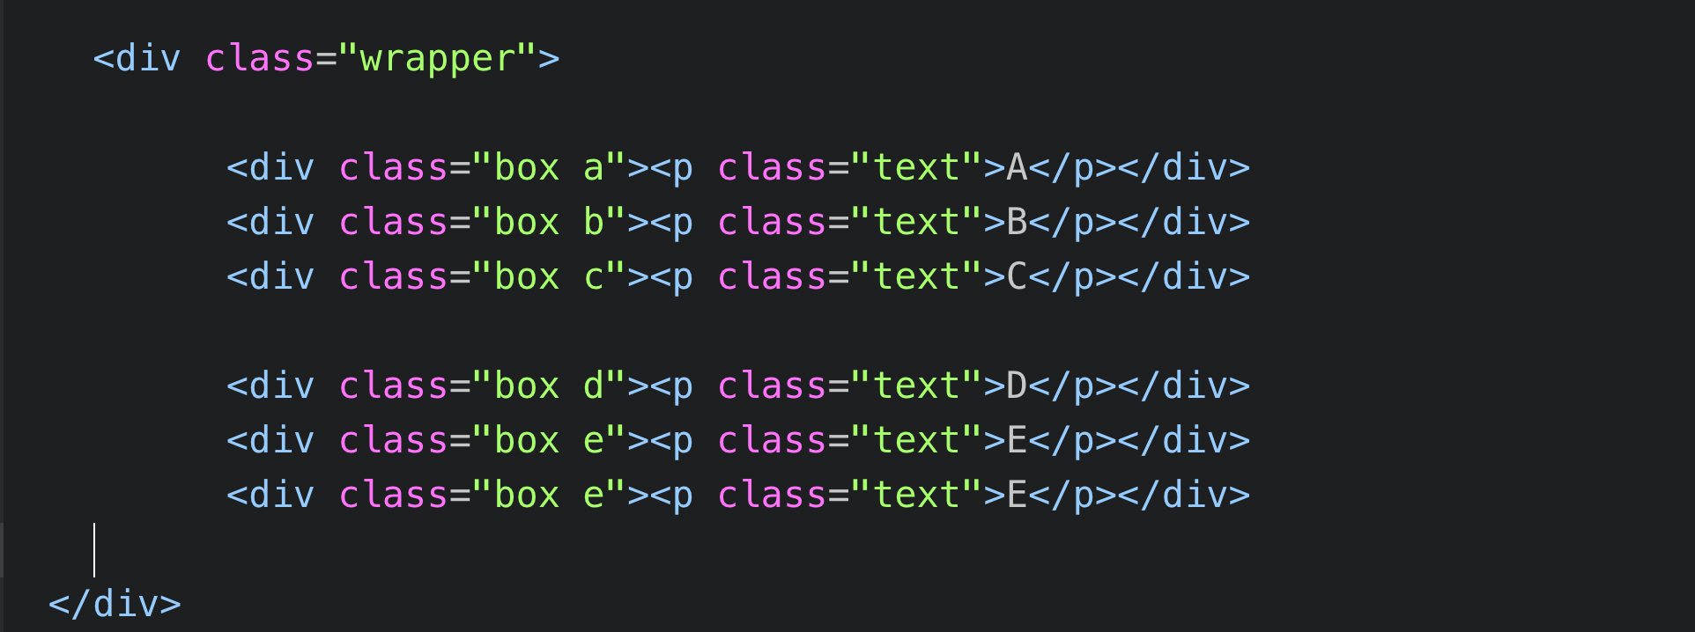
Lets Assume we have this Div Tags and we want to arrange them in a Nice way using Css Grid Layout

Slide 46
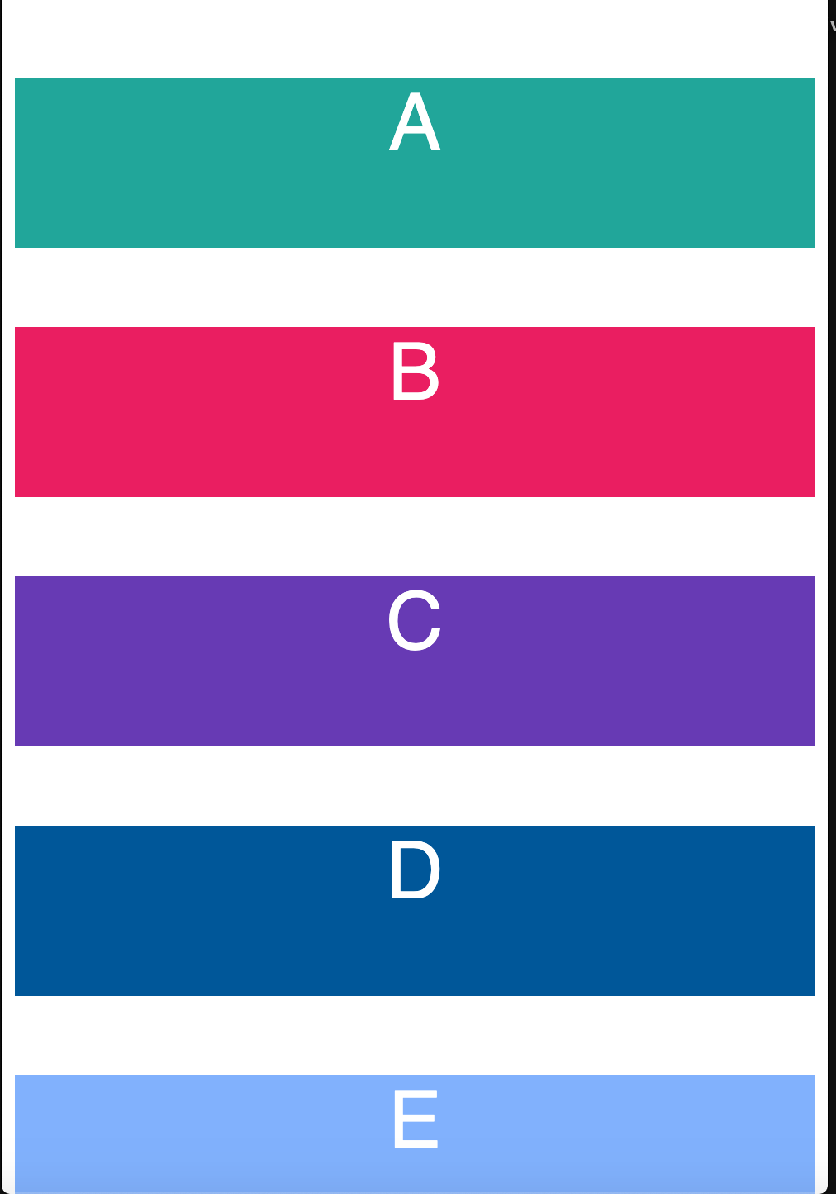
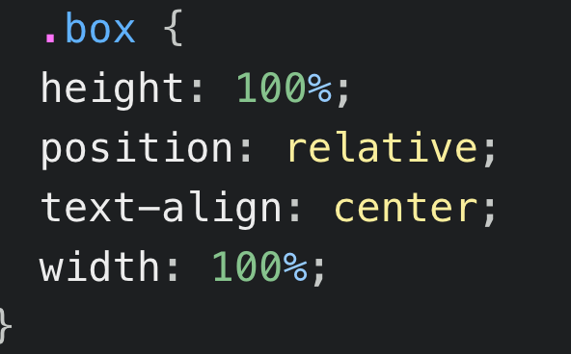
This will align everything in center

Slide 47
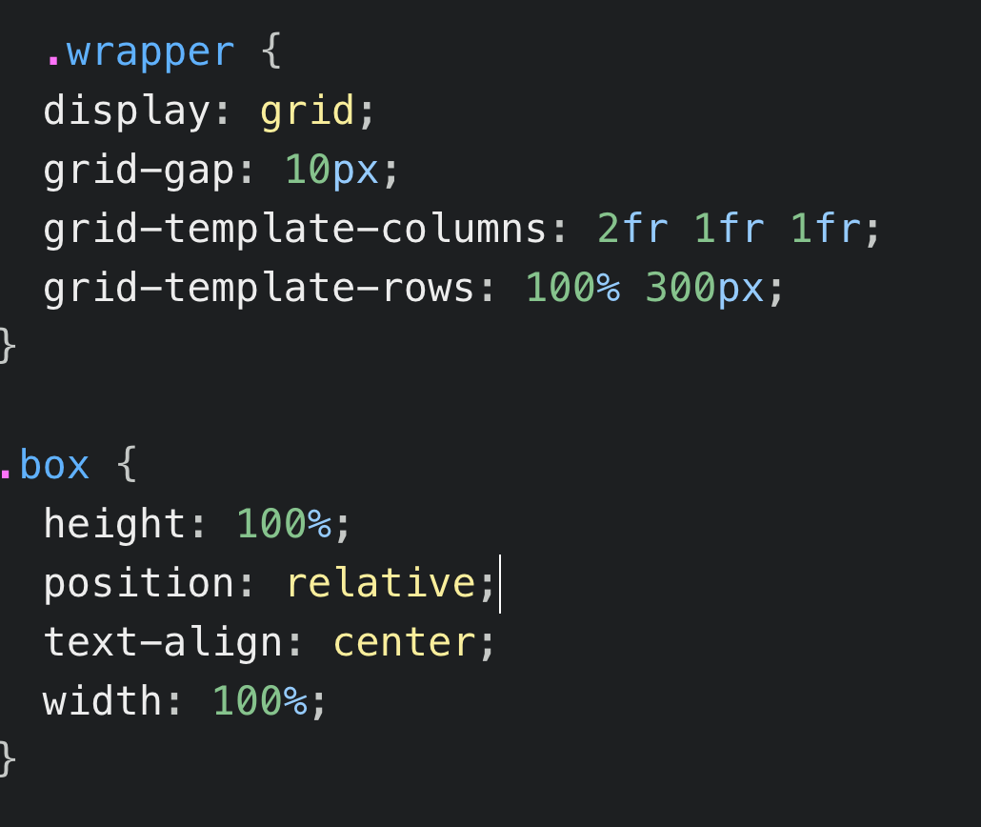
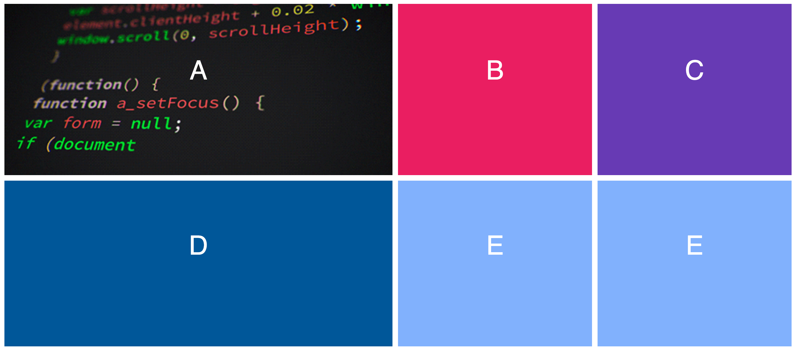
Grid Layout

Slide 48
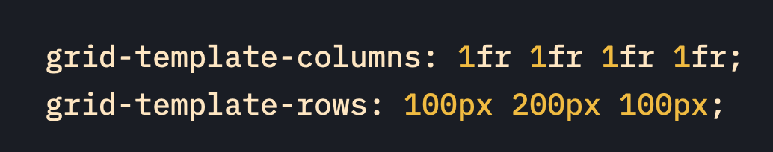
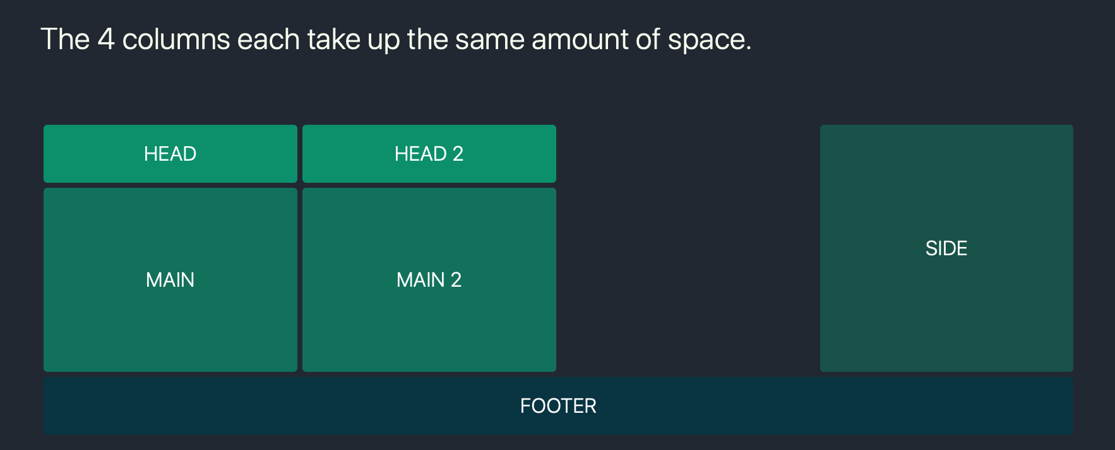

Slide 49
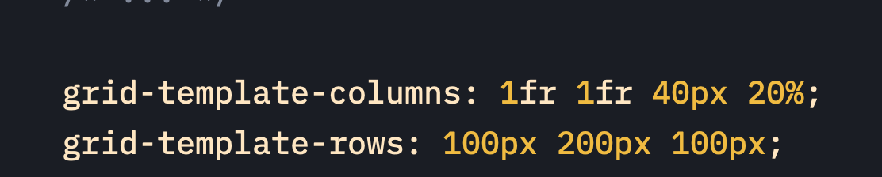
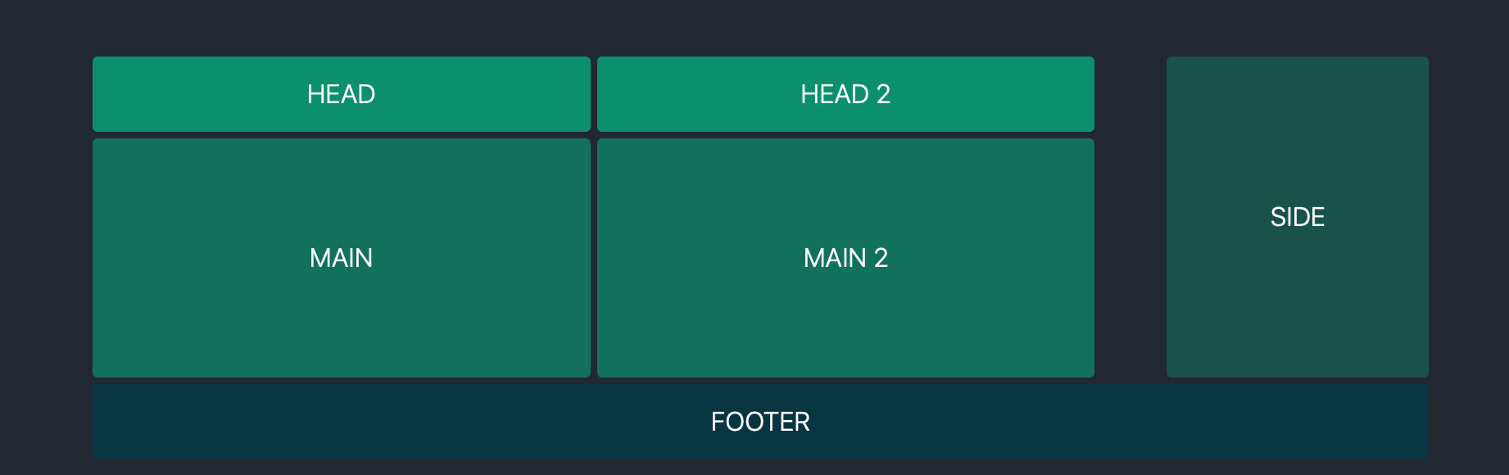


Slide 50
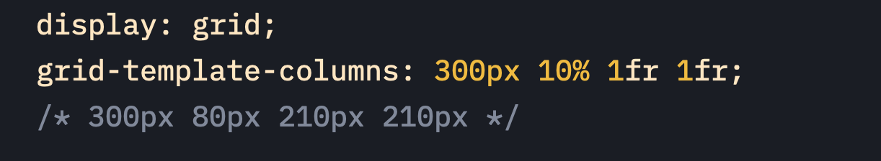
Mixed Units

Slide 51
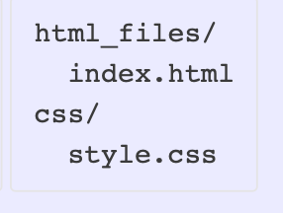
Organizing code in Folder

Slide 52
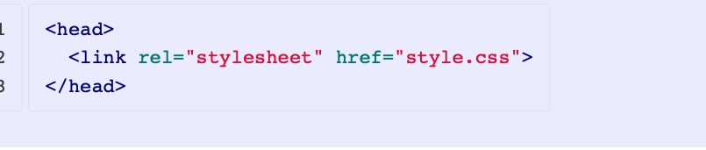
Linking a CSS File
In order for CSS styles to be applied to an HTML document, the two files have to be linked with a <link> element, and they get linked in the <head> of the HTML document. Without the link, the HTML file would have no knowledge of the CSS file, and the two would not be connected.
To link an HTML file to a CSS file, we need to add a <link> element in the head of the HTM
href is the filename (and location) of the .css file
rel indicates the relationship of the .css file to the .html file, and for a stylesheet that is stylesheet

Slide 53
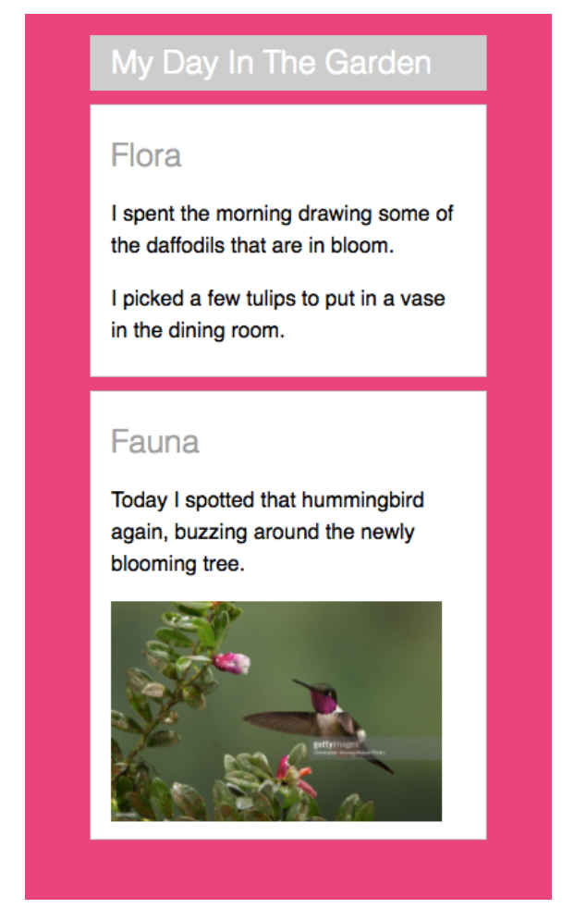
Exercise 1

Slide 54

Move to Atom Ide

Slide 55
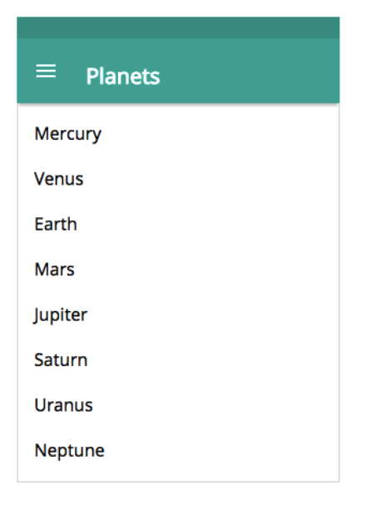
Exercise 2

Slide 56
Move to Atom Ide

Slide 57
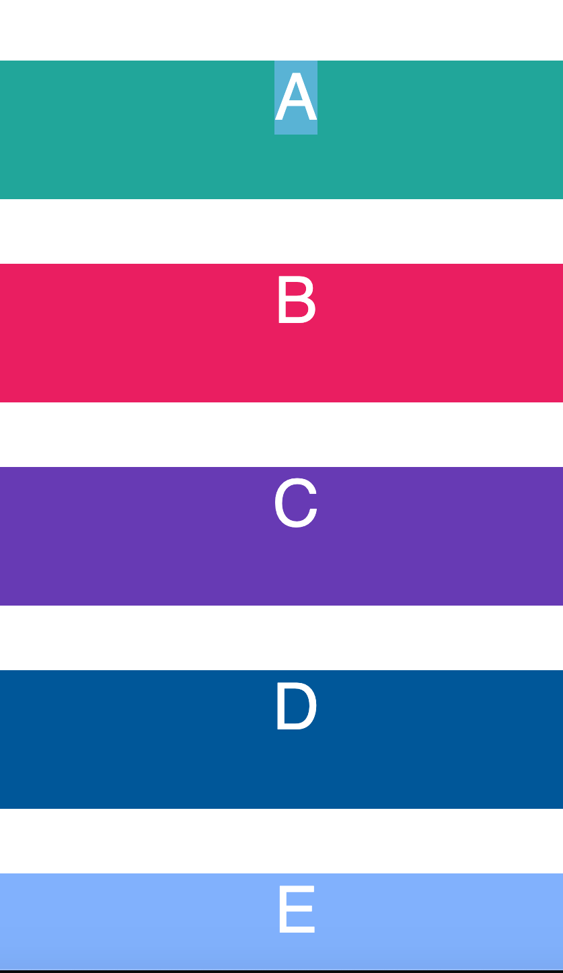
CSS Exercise 3

Slide 58
Move to Atom Ide

Slide 59

Bootstrap Snippets

Slide 60

Understanding Bootstrap Snippets

Slide 61
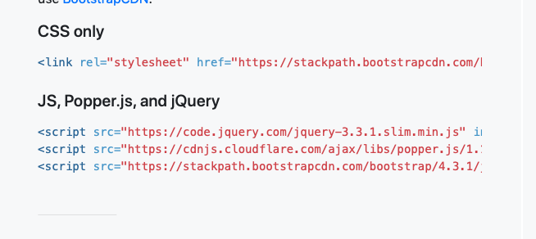
We need This Bootstrap Link

Slide 62
Understanding Nav Bar

Slide 63
Move to Atom Ide

Slide 64
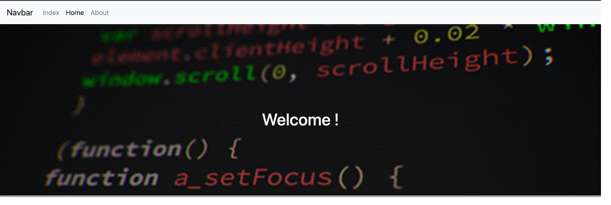
Making a Website

Slide 65
Introduction to Java Script

Slide 66
What is Scripting Language ?
Scripting is something that happens behind the scenes of every interactive website. A script can:
determine how the website behaves in response to clicks or interactions made by the user.
automate the execution of tasks or events that happen on a site.
be opened and edited with the help of a basic text editor.

Slide 67
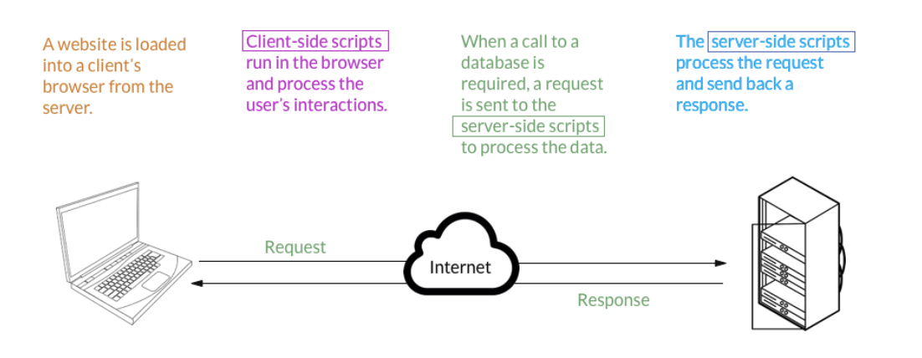
Diagram shows how scripting Language Works

Slide 68
When Do We Use Scripting?
Scripts are not visible to the user, but they are the code that is written that makes a website responsive to the user’s actions. When a user clicks a button, hovers over an icon, or interacts in any way, a script can determine how the website behaves in response to the user’s action.
We use scripting in both the front- and back-end of our applications.

Slide 69
Basics of Java Script
What Are Data Types?
In computer science and computer programming, a data type - or simply “type” - is a classification of data which tells the compiler or interpreter how the programmer intends to use the data
Examples of some data types are:
Booleans (true, false)
String (text defined within quotes "")
Numbers (1, 3.14, 0.25)

Slide 70
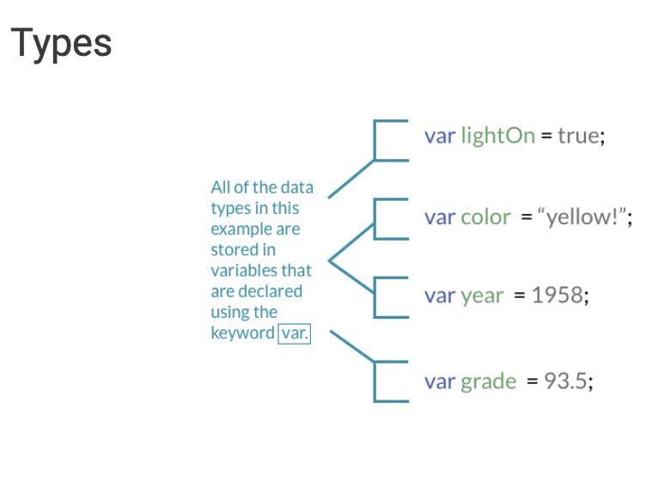
Data Types In Action

Slide 71
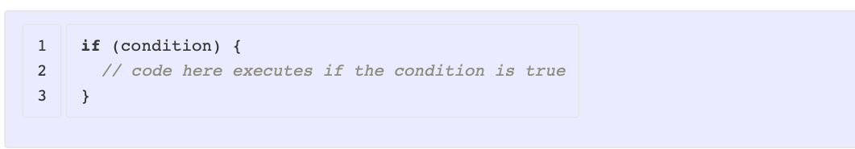
Control Structures
Control structures are how we introduce logical operations to our code based on the values of data types: sometimes when we only want something to happen if a certain condition is met, while other times we want to do an operation repeatedly. These two types of control - conditionals and loops - are foundational to programming.

Slide 72
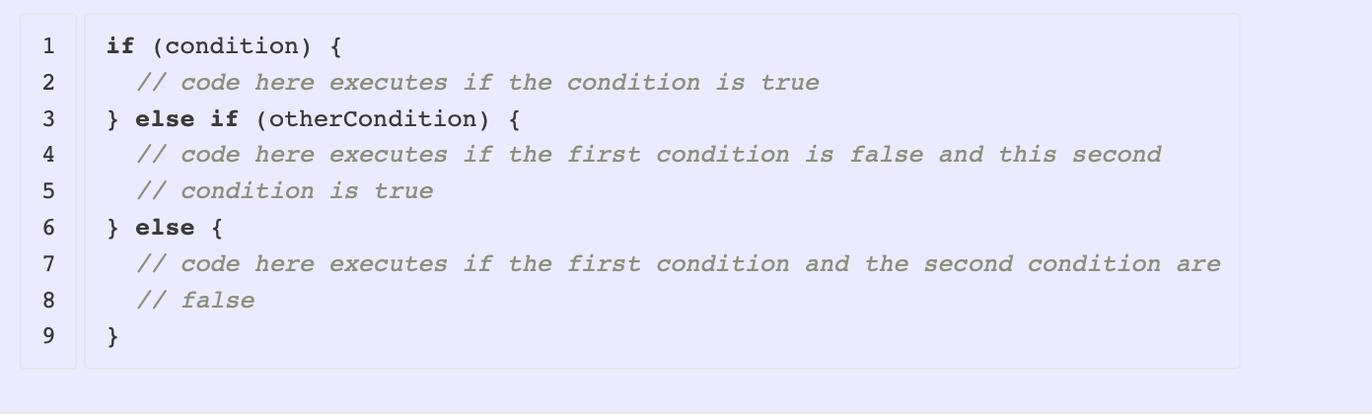
if statements can be expanded using else statements and else if statement

Slide 73
Conditions
Conditions can be variables that are true or false, or can be statements that use comparison and logical operators. The operators compare two values to determine equality, inequality, or relative scale; some operators can be used with various data types (=== for equality), while others don’t make sense with some data types (is "red" > "blue"?).
Some of the most common comparison operators are:

Slide 74
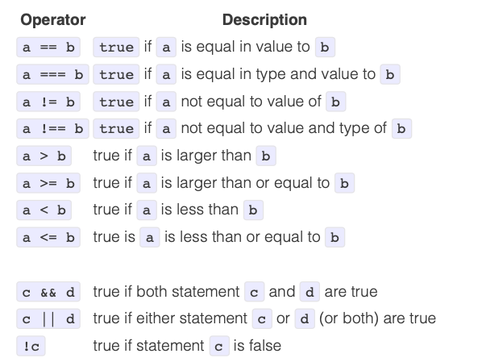
Conditions Operator

Slide 75
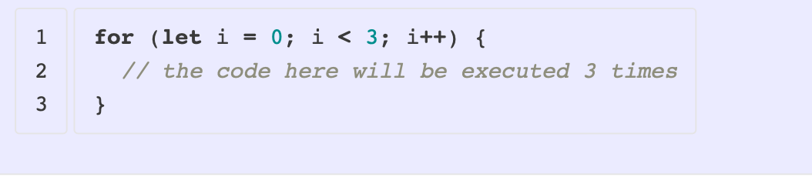
Loops

Slide 76
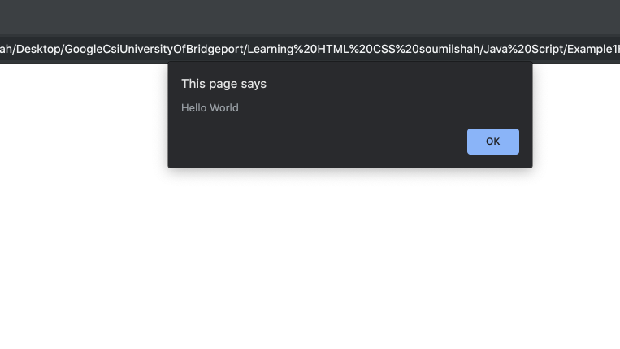
Alert();

Slide 77
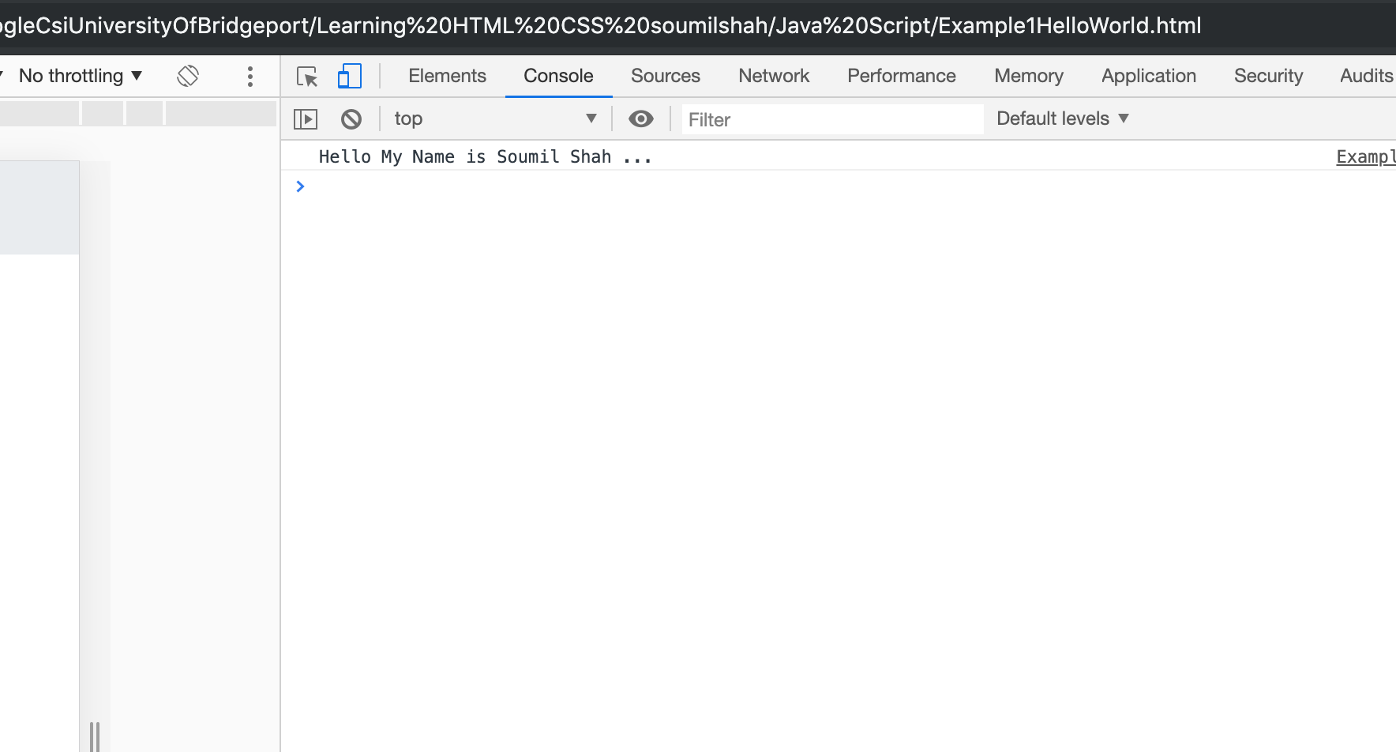
Console.log();
Takes a String or variable and used for debugging

Slide 78
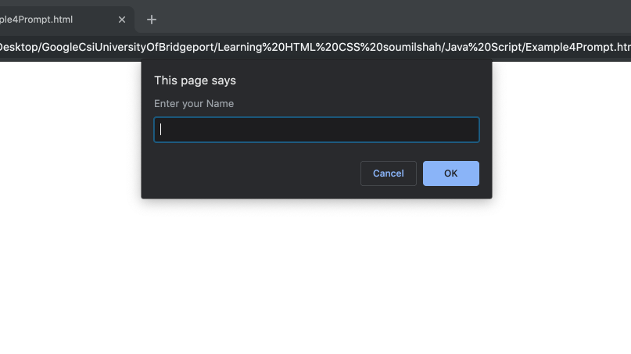
Prompt();

Slide 79
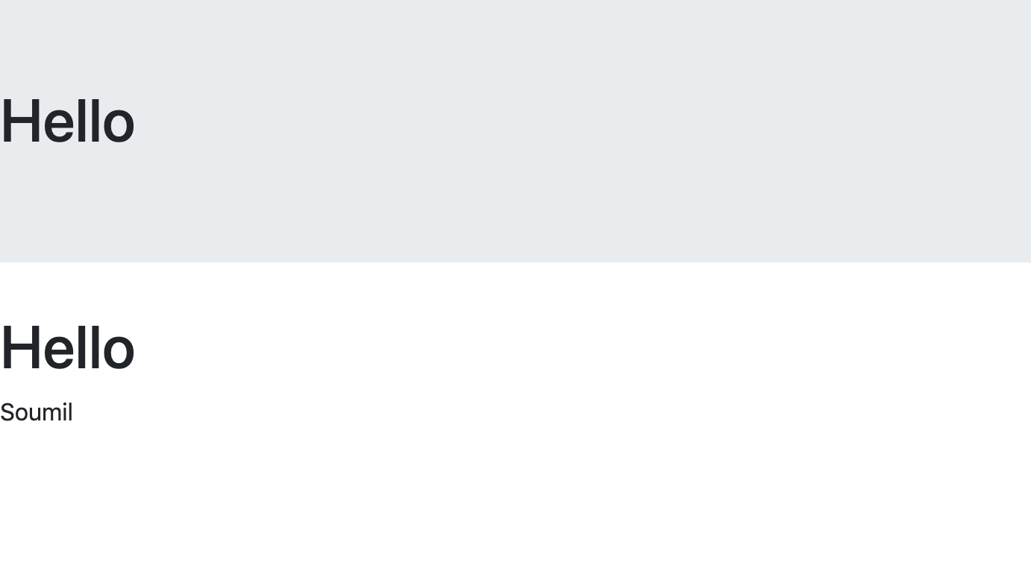
Document.write(“<h1> Hello !!</h>”)

Slide 80
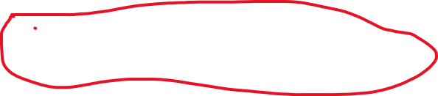
Java Script Selector
getElementsByClassName('className')
getElementById('id')
getElementsByTagName('tagName')
document.querySelector('selector');

Slide 81
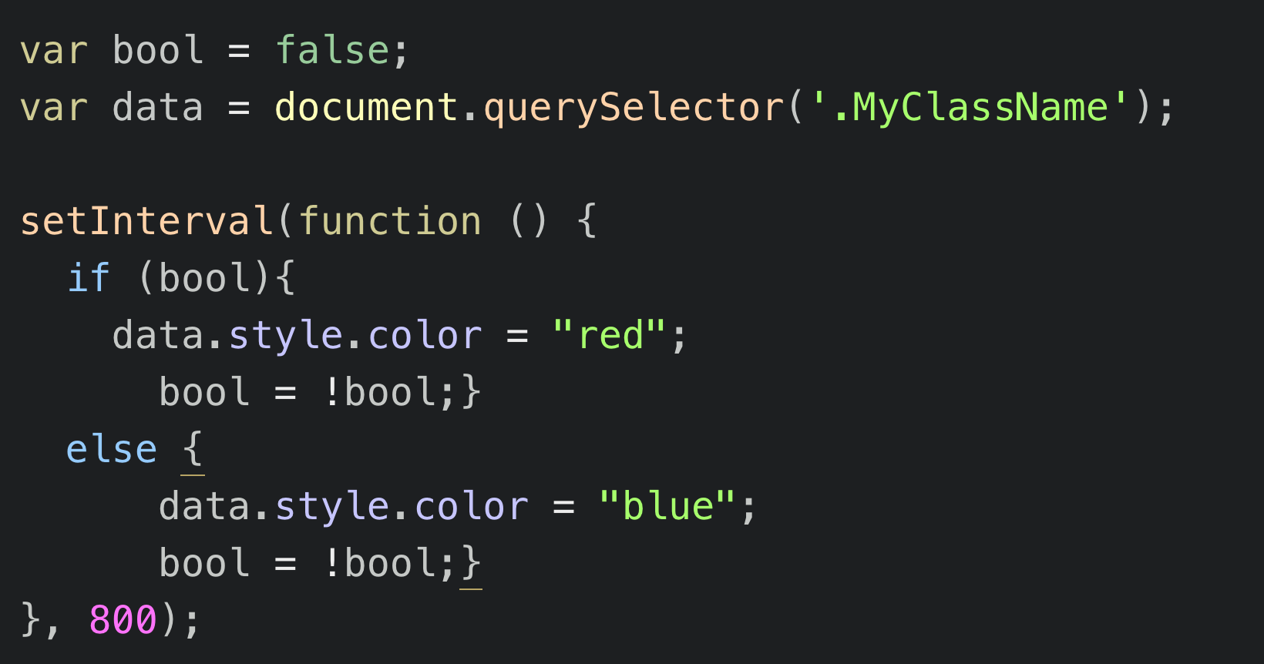
Flashing Message setInterval()

Slide 82
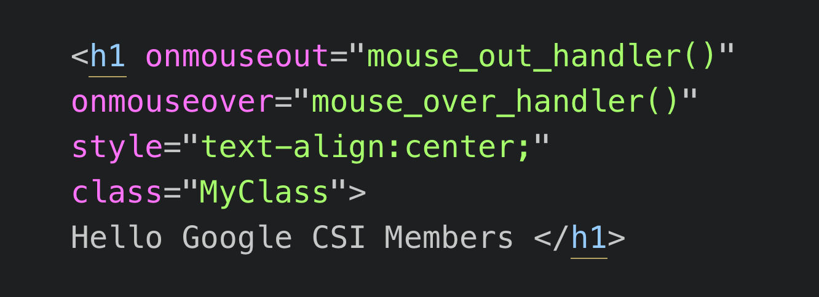
Java Script with Forms and Events

Slide 83
Thank you

